Slide 1
+ Implementation Weekend
Treasury Module
Church treasurers embracing digital transformation together, one click at a time
BUC | NEC | SEC | IM | SM | WM
17-19 May 2024

Slide 2
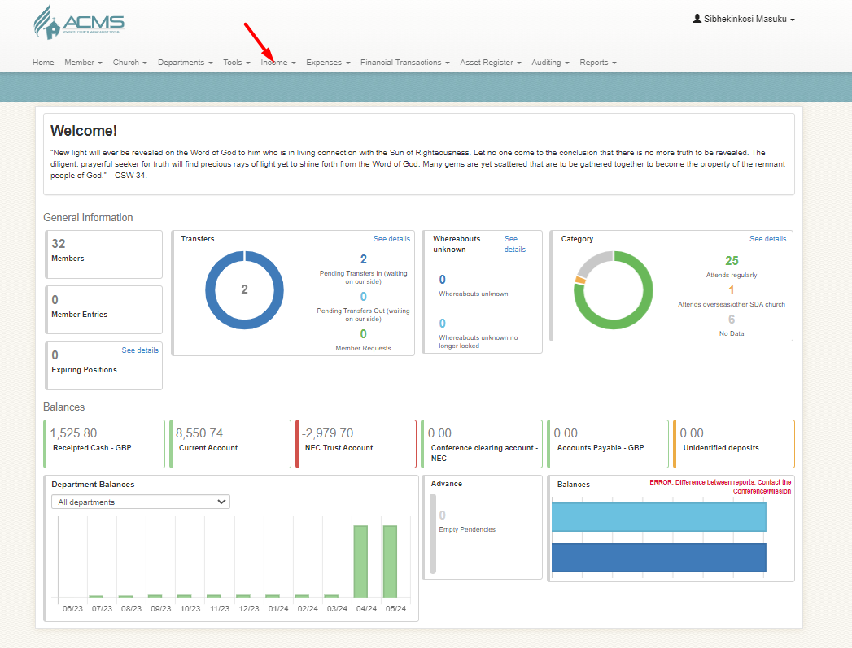
How to record income in ACMS

Slide 3
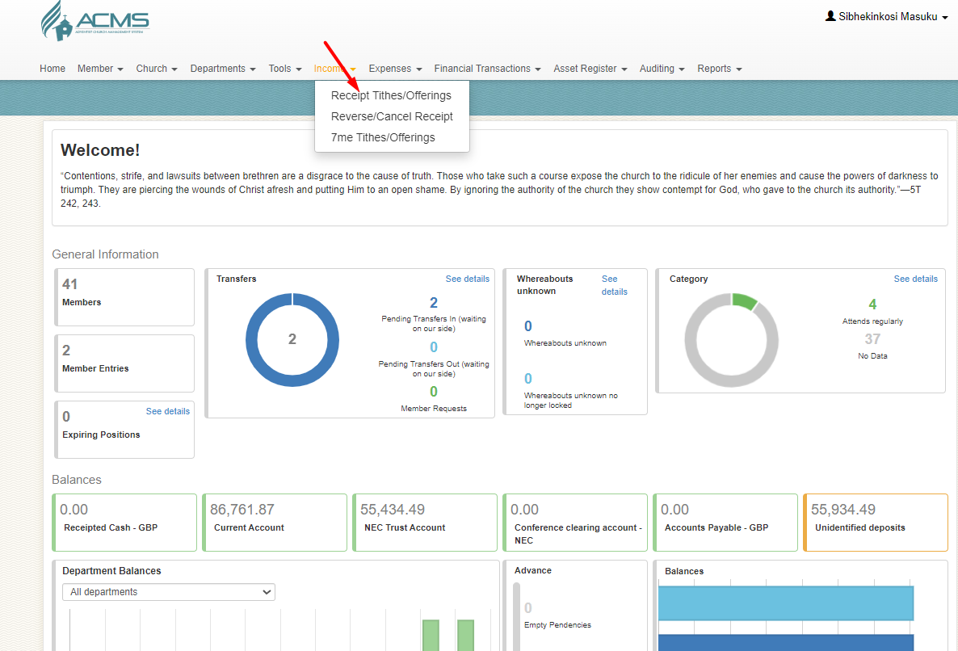
Click on Receipt Tithes/Offerings
Church treasurers embracing digital transformation together, one click at a time

Slide 4
Click Create a New Batch

Slide 5
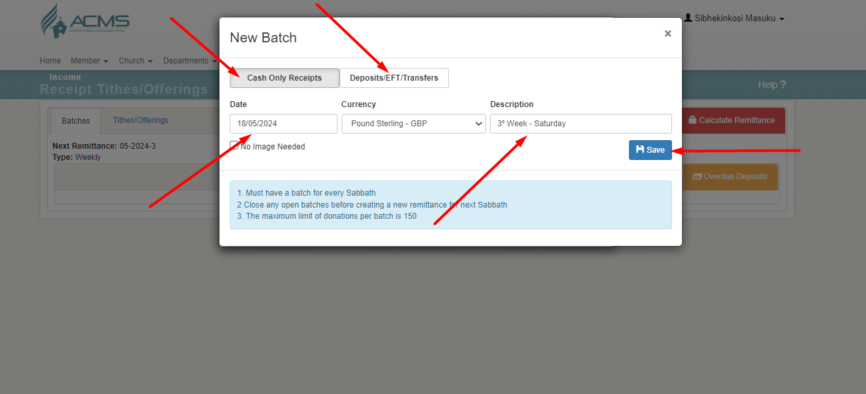
Select an appropriate Batch

Slide 6
Select the Batch then Click Capture

Slide 7
Populate as appropriate

Slide 8
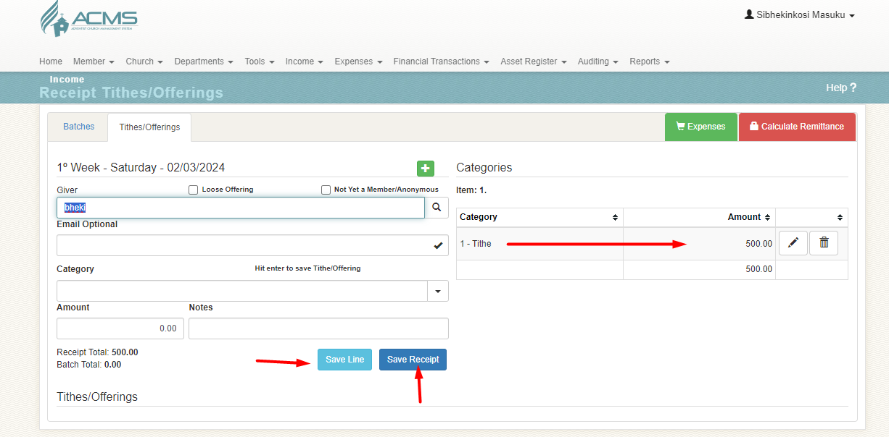
Save the Line/ once finish Save receipt

Slide 9
Restricted Local offerings use 55 category

Slide 10
Select correct department for Restricted funds

Slide 11
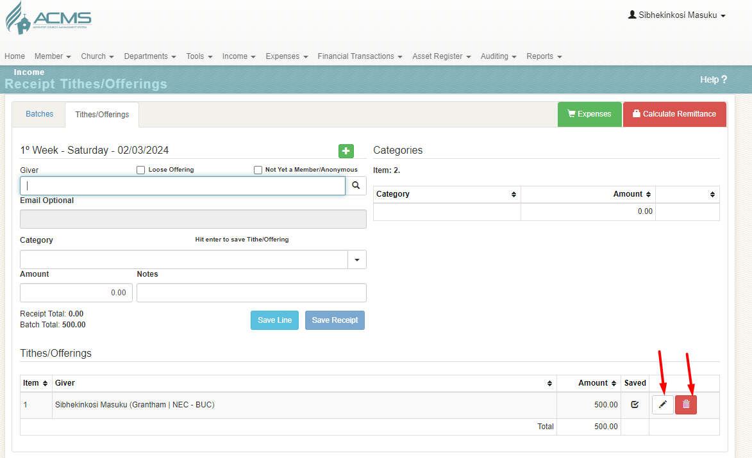
Mistake happens how to edit an entry

Slide 12
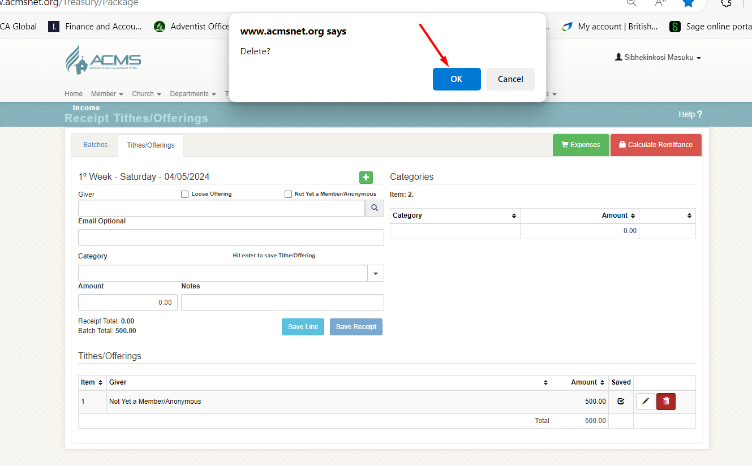
To Delete an entry

Slide 13
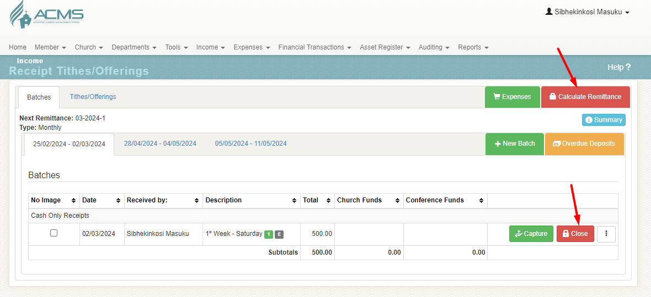
How to close the Batch

Slide 14
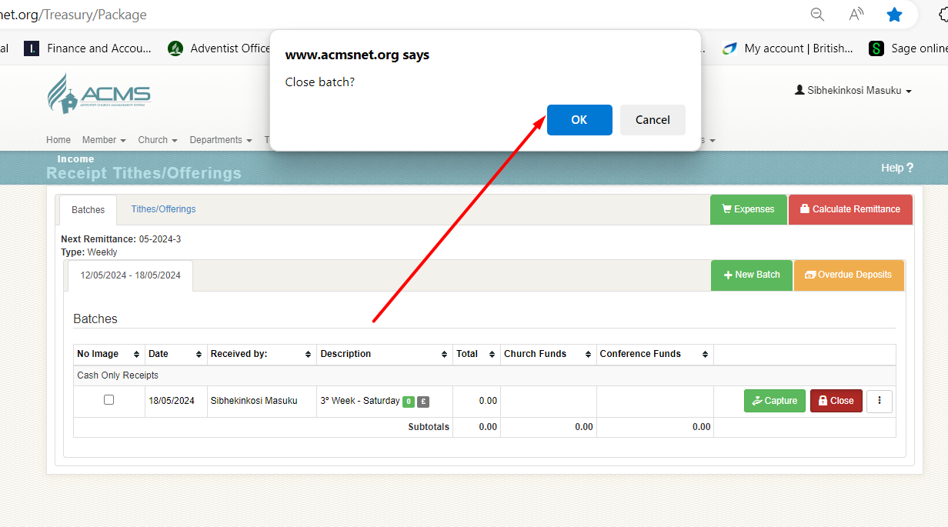
Close off the Batch

Slide 15
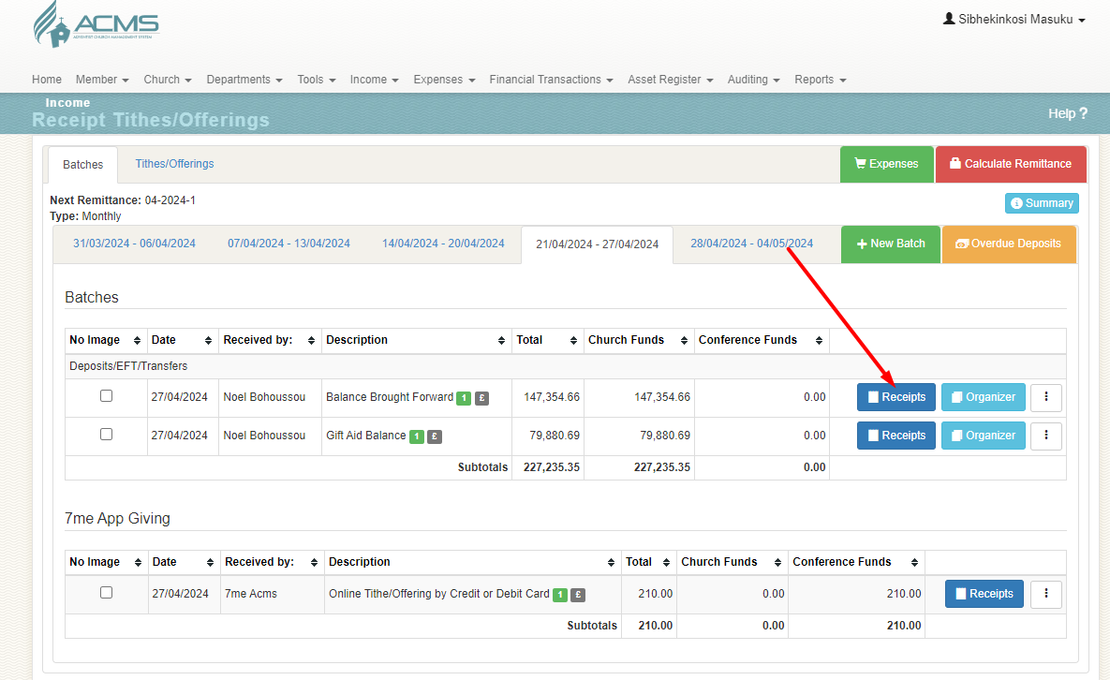
How to View your Receipts

Slide 16
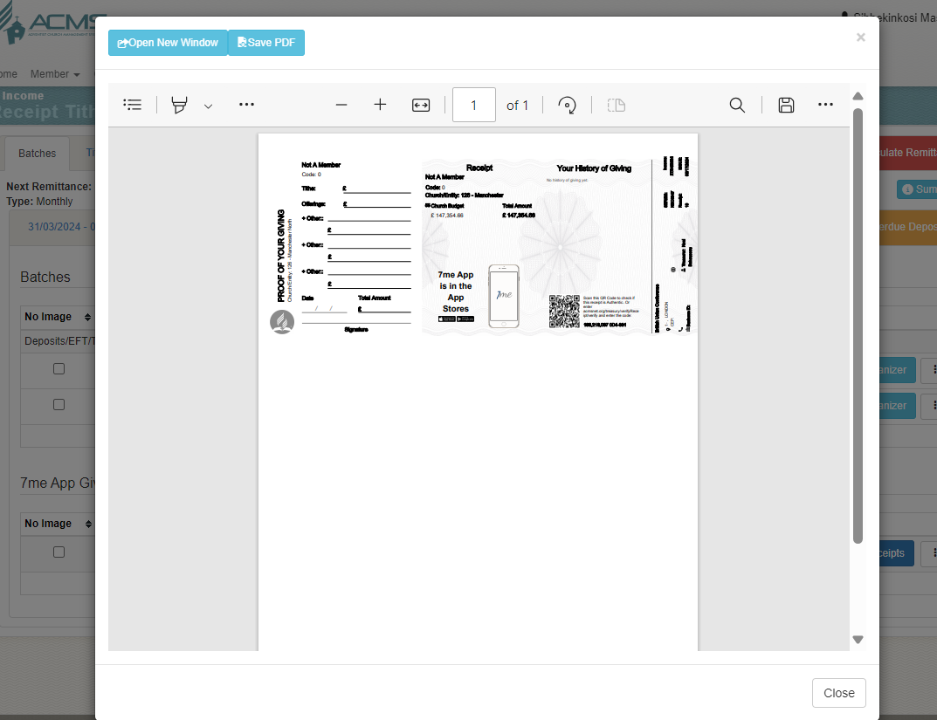
Look of the Receipts

