Slide 1
+ Implementation Weekend
Treasury Module
Church treasurers embracing digital transformation together, one click at a time
BUC | NEC | SEC | IM | SM | WM
17-19 May 2024

Slide 2
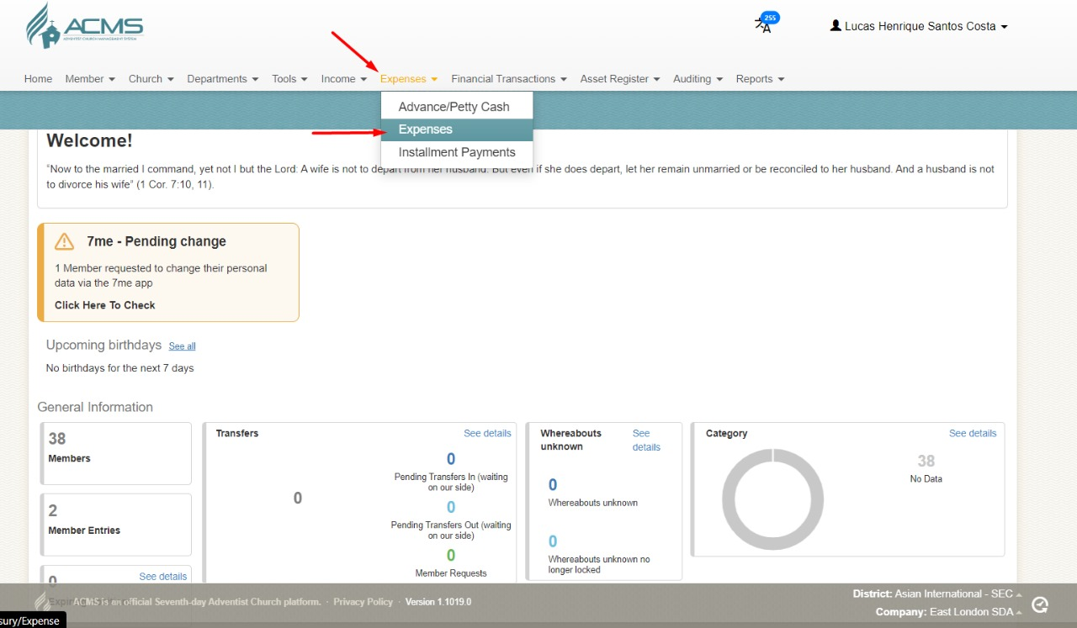
How to record Expenses on ACMS
1. Expense Menu > expense option

Slide 3
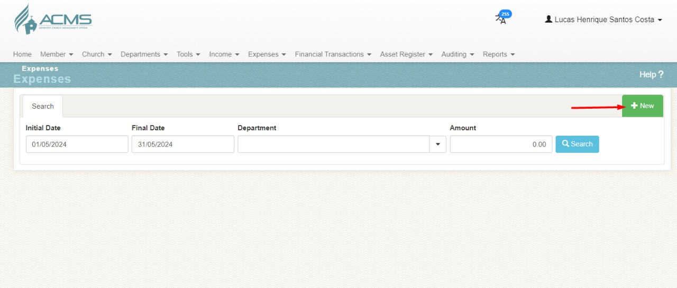
How to record Expenses on ACMS
2. Click > ‘New’ option

Slide 4
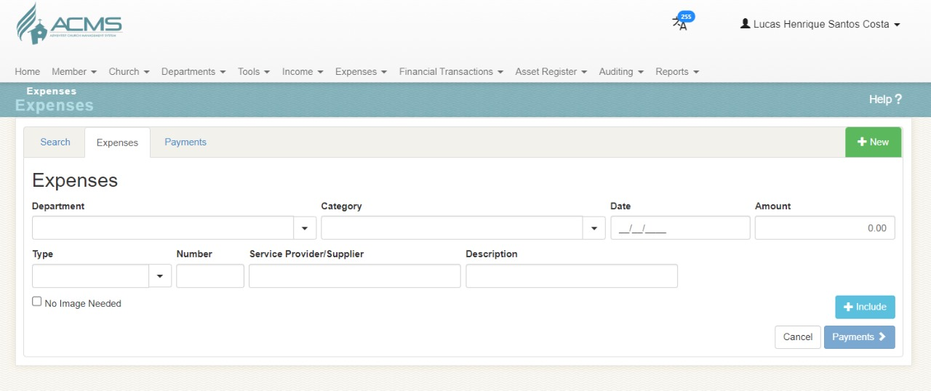
How to record Expenses on ACMS
2. Click > ‘New’ option

Slide 5
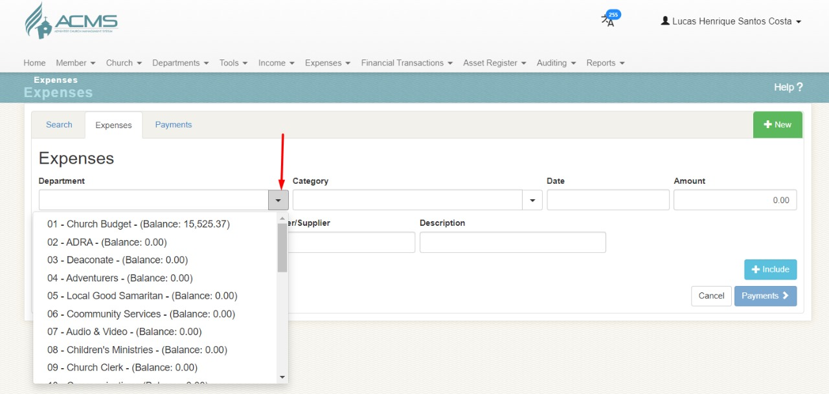
How to record Expenses on ACMS
3. Select > Department

Slide 6
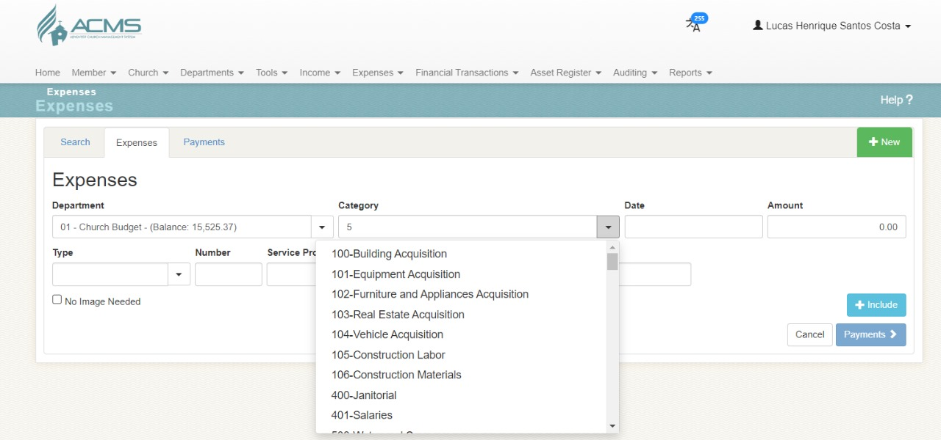
How to record Expenses on ACMS
4. Select > Category

Slide 7
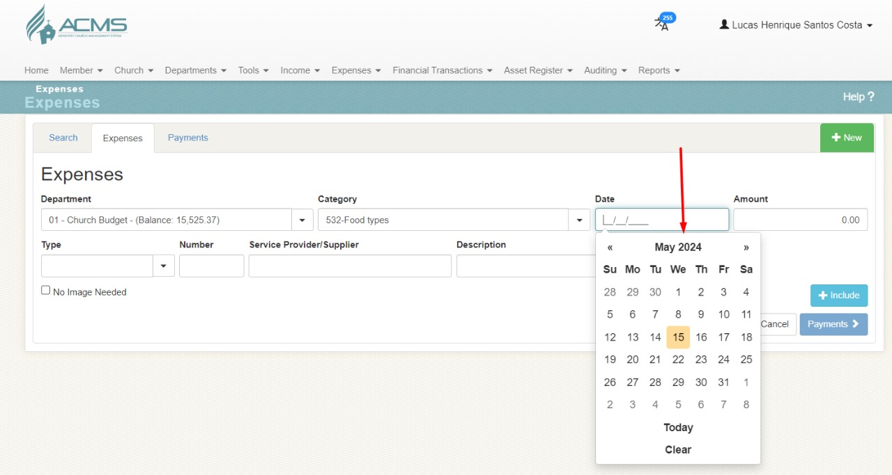
How to record Expenses on ACMS
5. Select > Date

Slide 8
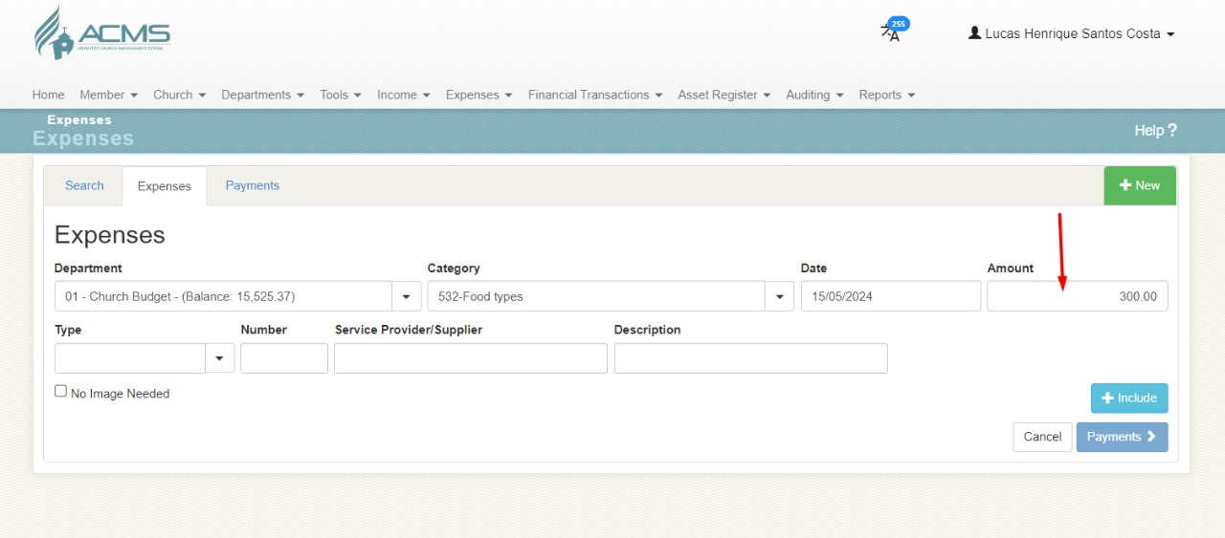
How to record Expenses on ACMS
6. Add > Amount

Slide 9
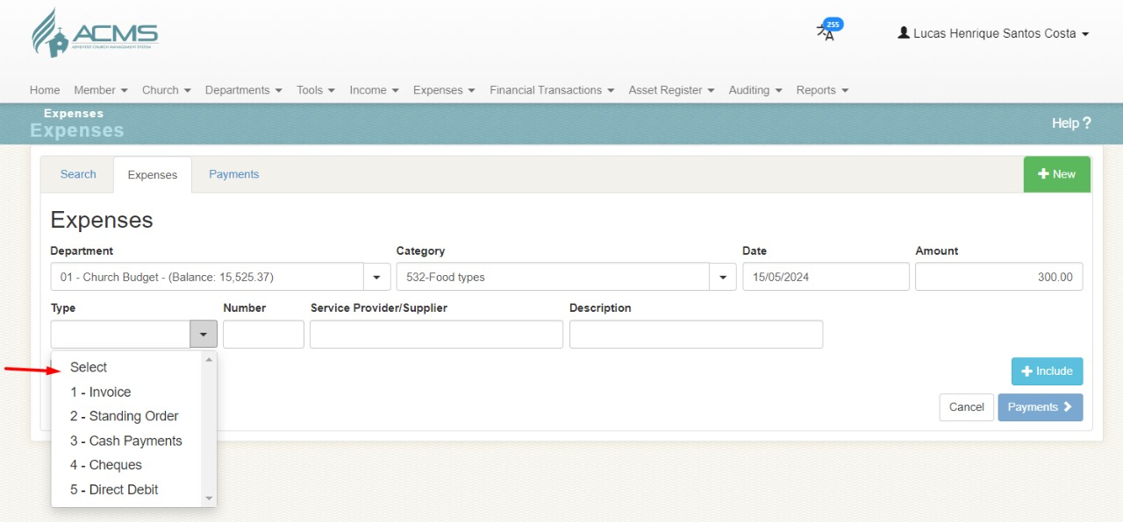
How to record Expenses on ACMS
7. Select > Type

Slide 10
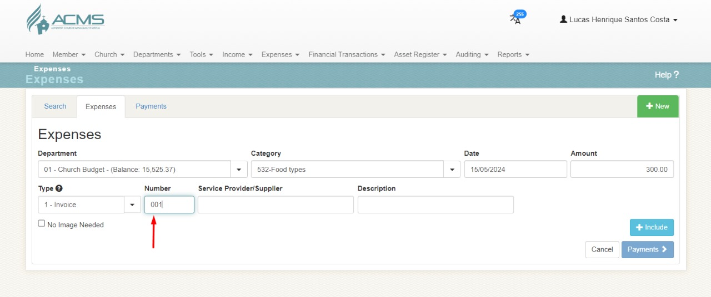
How to record Expenses on ACMS
8. Add > Type number (e.g. Invoice, Cheques etc)

Slide 11
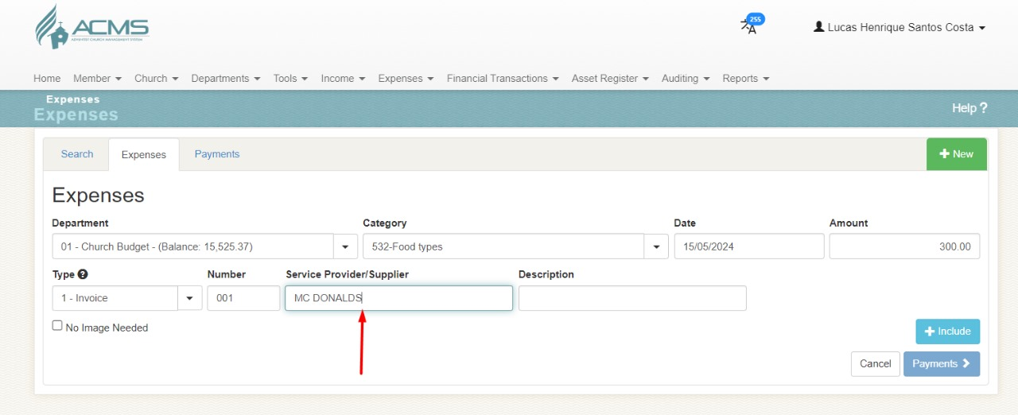
How to record Expenses on ACMS
9. Add > Supplier Details

Slide 12
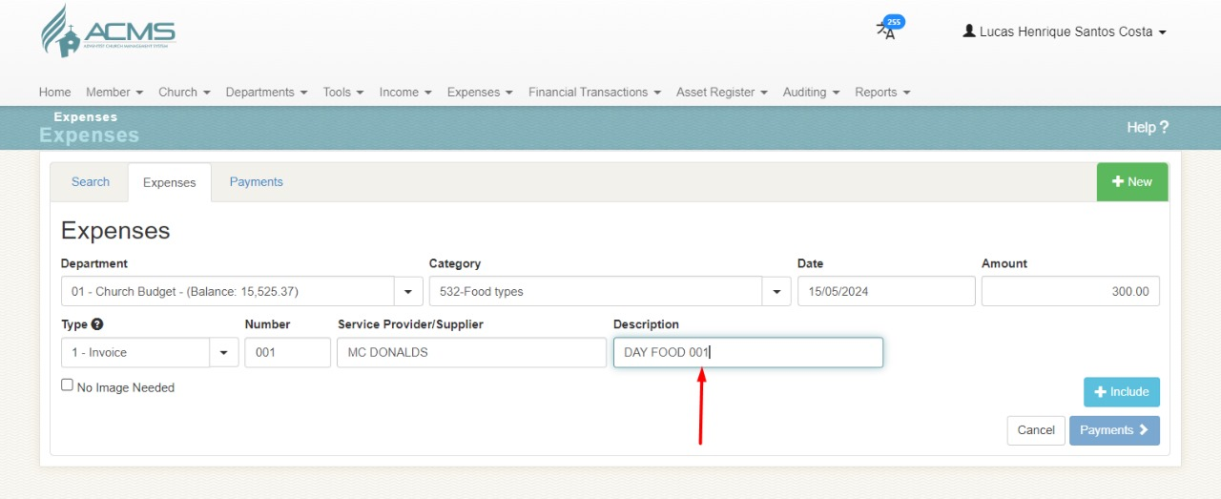
How to record Expenses on ACMS
10. Add > Description

Slide 13
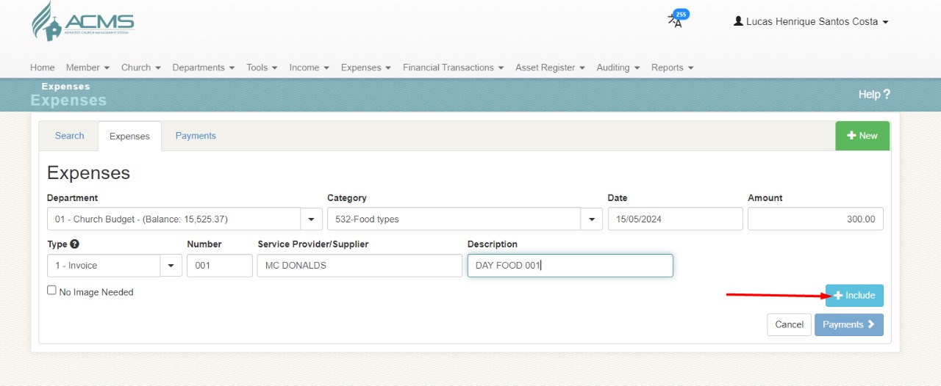
How to record Expenses on ACMS
11. Click > Include

Slide 14
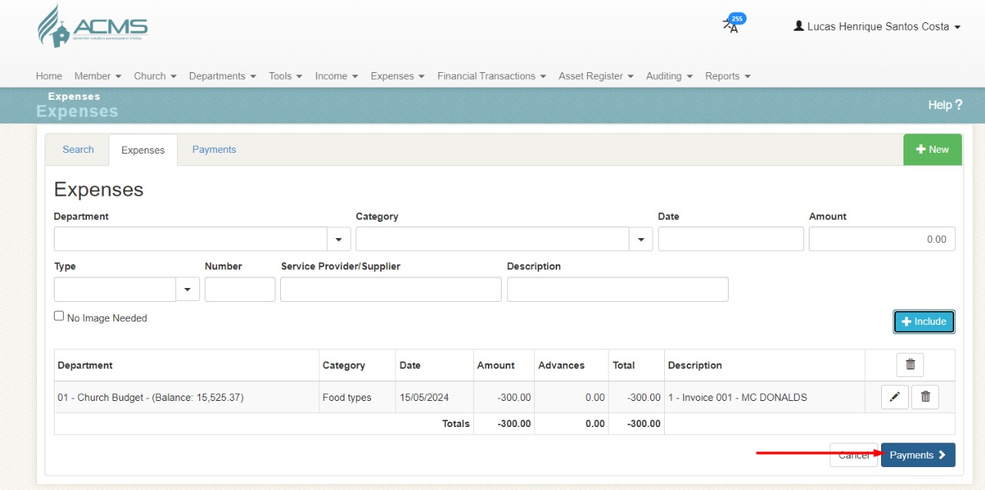
How to record Expenses on ACMS
12. Click > Payment

Slide 15
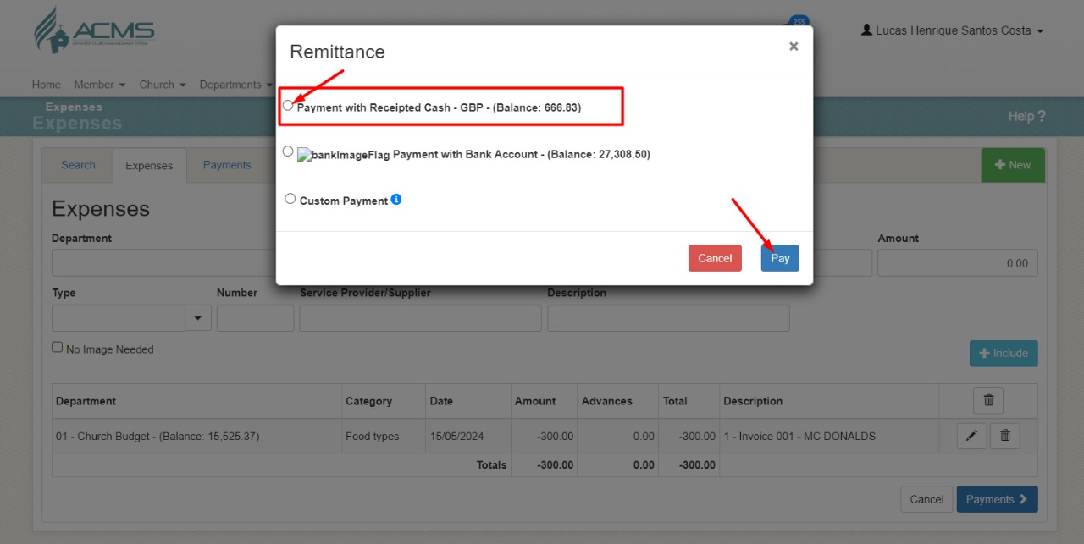
How to record Expenses on ACMS
13. Click > Pay – Chose one of the options

Slide 16
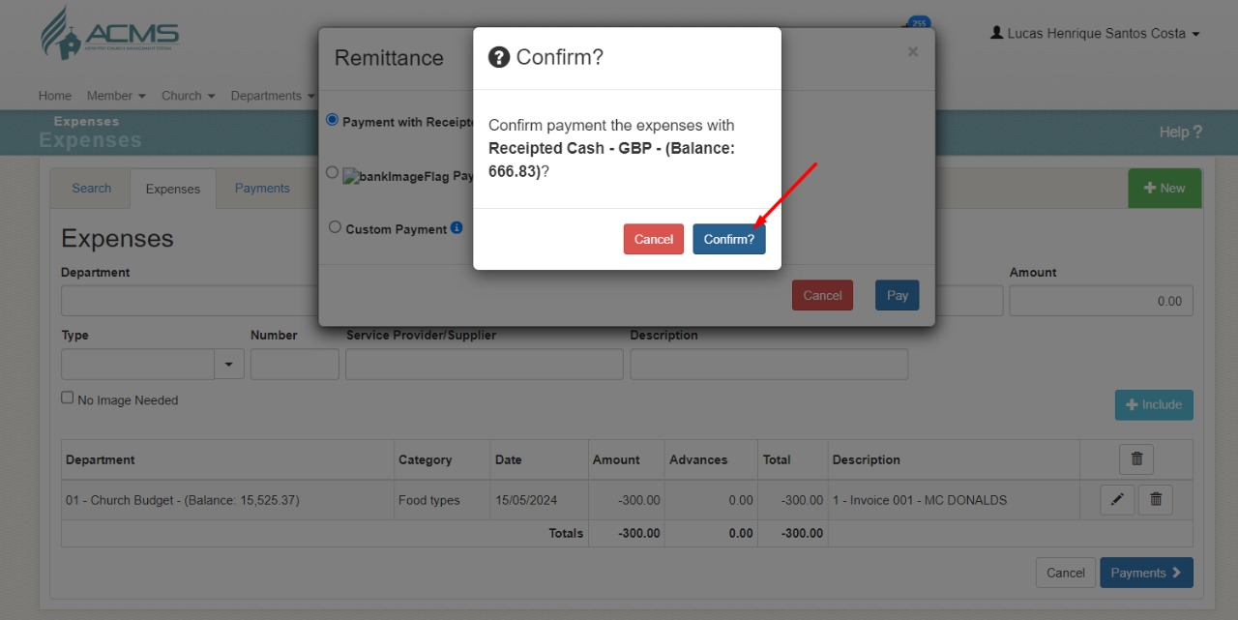
How to record Expenses on ACMS
14. Click > Confirm

Slide 17
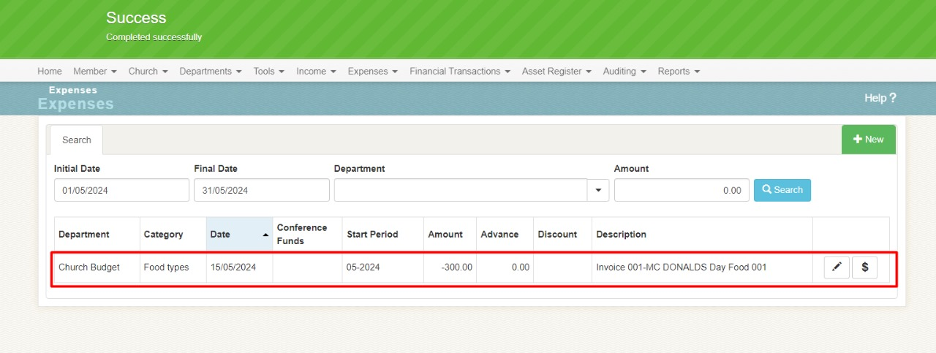
How to record Expenses on ACMS
15. Payment > Completed Successfully

Slide 18
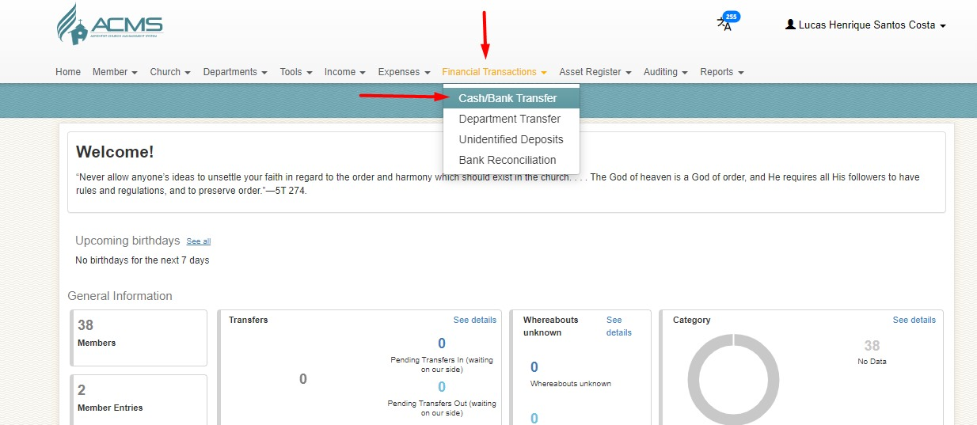
Bank Transfer
1. Financial Transaction> Cash/Bank Transfer

Slide 19
Bank Transfer
2. Click > New

Slide 20
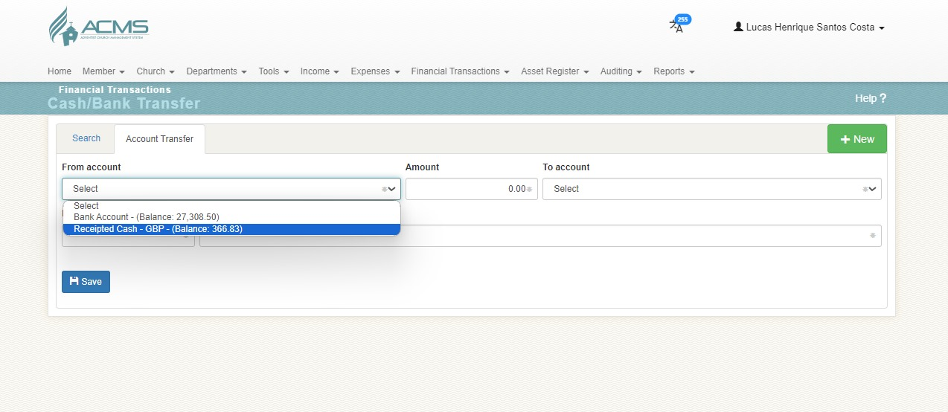
Bank Transfer
3. Select > from account

Slide 21
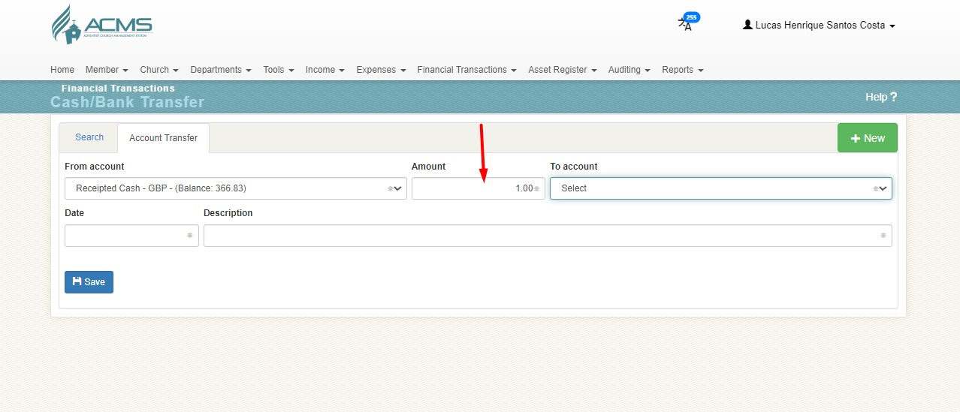
Bank Transfer
4. Add > amount

Slide 22
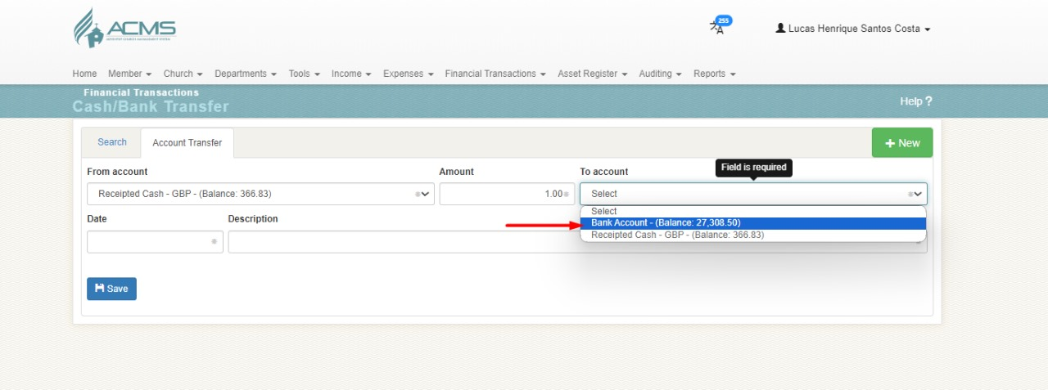
Bank Transfer
5. Select > to account

Slide 23
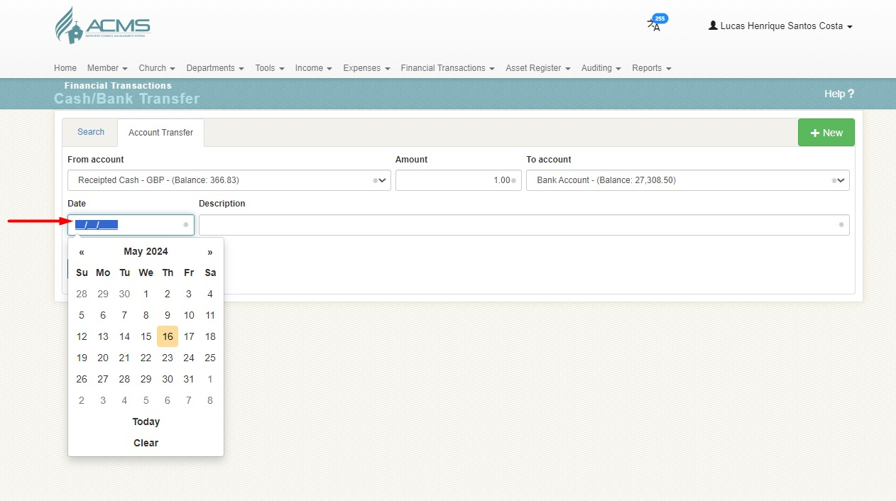
Bank Transfer
6. Select > Date

Slide 24
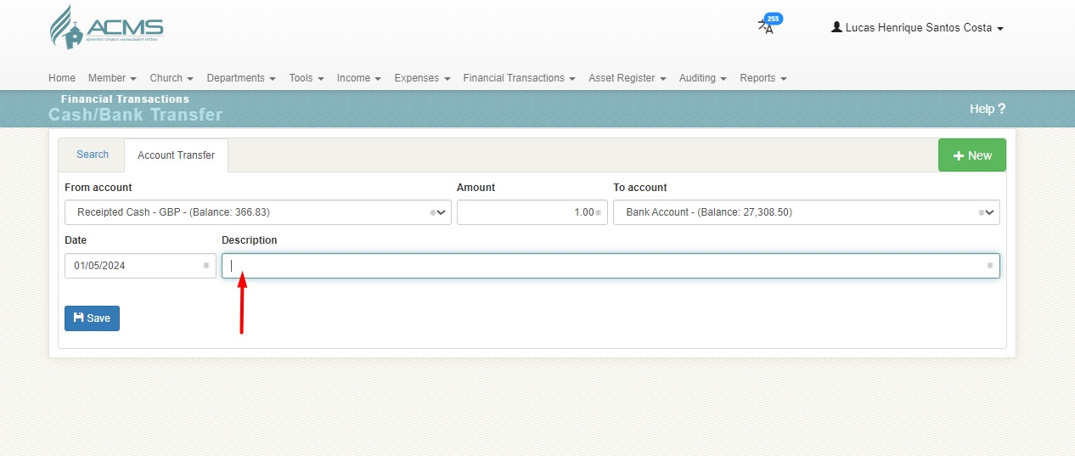
Bank Transfer
7. Add > Description

Slide 25
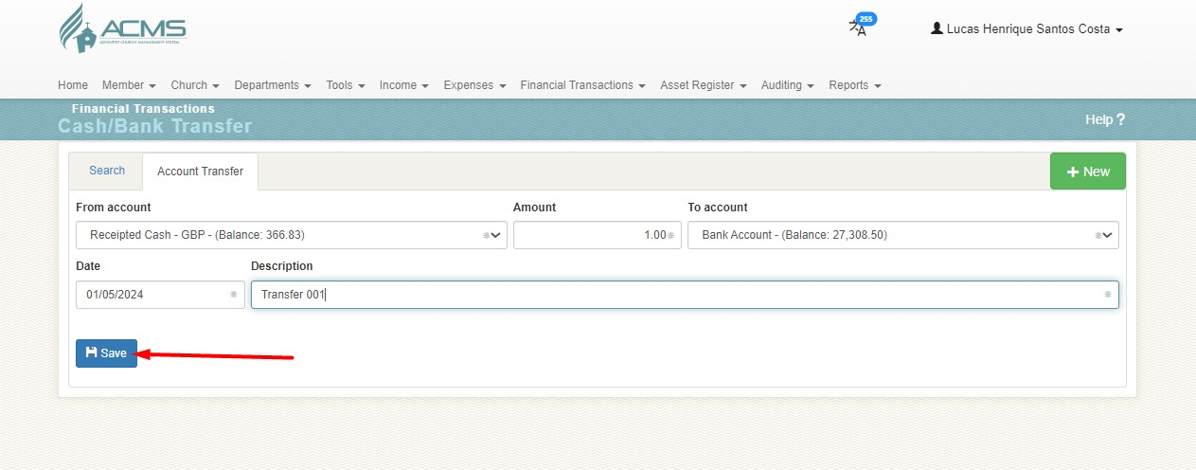
Bank Transfer
8. Add > Description

Slide 26
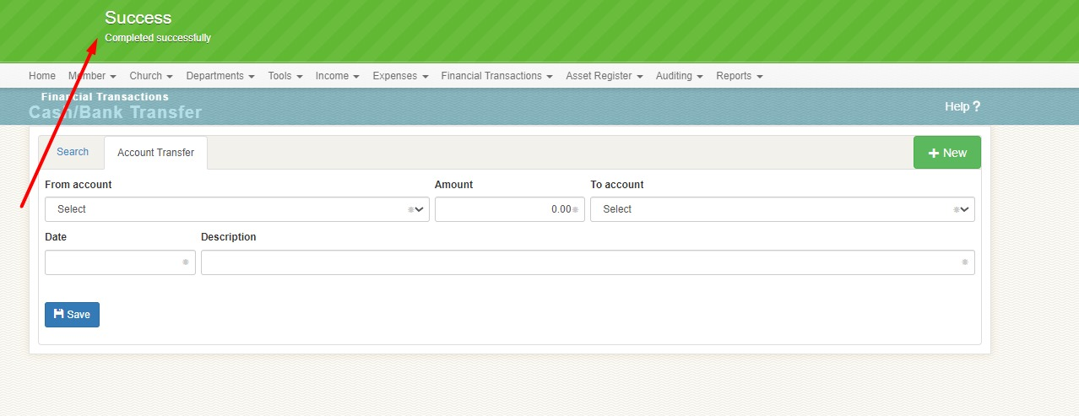
Bank Transfer
9. Bank Transfer > Completed Successfully

Slide 27
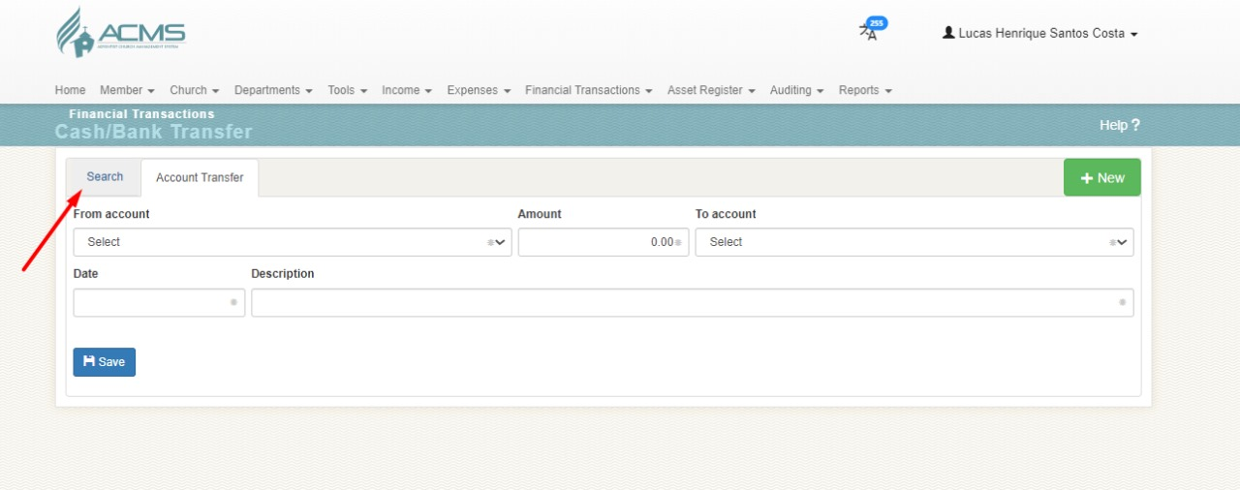
Bank Transfer
10. Search

Slide 28
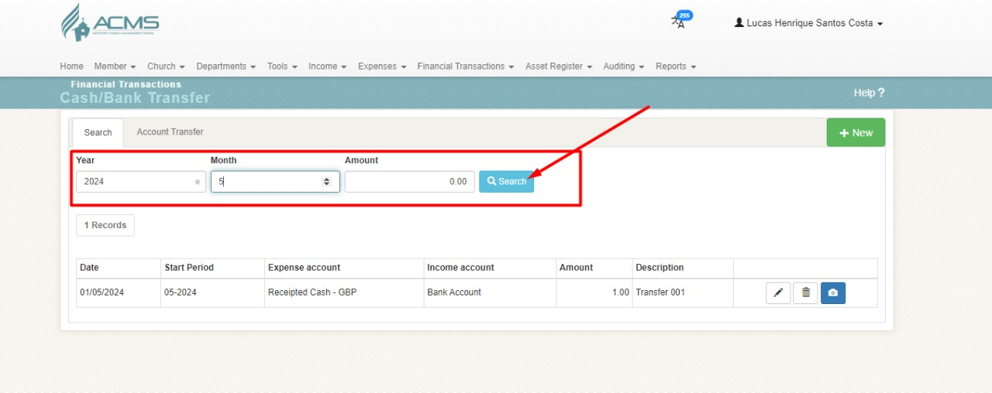
Bank Transfer
11. Search > year and month

Slide 29
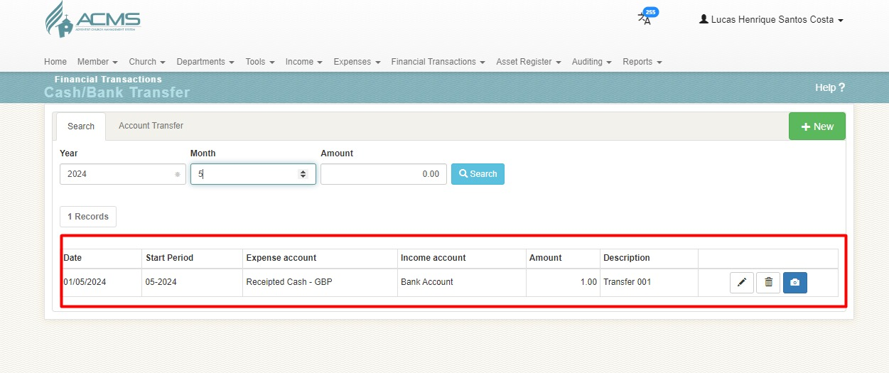
Bank Transfer
12. Search

